Slide 1

Weather App
(BMICSE0555/BCSE0555/BCSEH0555)
Department of Information Technology
(Submitted To: Mr. Ankur Chaudhary)
Group Members
Name of Member | Roll Number | Role | Department n Section
Vaibhav Agrawal | 2301330130197 | Frontend | IT ‘C’
Simal Agrahari | 2301330130182 | Backend | IT ‘C’
Sparsh Rawat | 2301330130184 | Database | IT ‘C’
Vikash Giri | 2301330130204 | Documentation | IT ‘C

Slide 2

Index
Introduction
Literature Survey/Existing System
Problem Statement
Proposed Methodology
Flowcharts and Use Case/ER Diagrams
Feasibility Study
Hardware /Software Requirement
Results and Conclusion
References
Live Demonstration of Project with screenshots in ppt

Slide 3
Abstract
Objective: Build a user-friendly platform for real-time, accurate weather updates.
User Interface:
Simple, intuitive front-end (HTML, CSS, JavaScript).
Search by city name or auto-detect current location.
Data Retrieval:
Asynchronous API calls (e.g., OpenWeather API).
Fetch key metrics: temperature, humidity, wind speed, weather description.
Real-Time Display:
Dynamic rendering without page reload.
Weather icons & multi-day forecasts for enhanced usability.

Slide 4
Introduction
An introduction for a weather forecast system project in web development should set the stage by defining the problem, stating the project's purpose, and outlining the solution.
About Weather App
Weather is a crucial factor in daily life, influencing everything from personal travel plans to agricultural and business operations. The need for timely, accurate, and easily accessible weather information is universal. While numerous weather services exist, they are often scattered across different platforms, lack a unified user experience, or are cluttered with excessive information.

Slide 5
ProblemStatement
Problem Statement
Weather apps are often complex, cluttered with ads, or fragmented across multiple platforms.
Users struggle to get accurate, real-time weather data quickly and easily.
Need/Gap
A simple, reliable, and user-friendly web app that delivers weather forecasts at a glance.
Focus on accuracy, accessibility, and seamless user experience without unnecessary distractions.

Slide 6
Objectives
User-Friendly Interface: Simple, clean, and clutter-free design for easy navigation.
Real-Time Data: Display accurate, up-to-date weather details (temperature, humidity, wind speed, conditions).
Key Features
Reliable API Integration: Connect with trusted weather APIs (e.g., OpenWeatherMap, WeatherAPI).
Search & Location Detection:
  Search weather by city.
  Auto-detect user location for personalized forecasts.

Slide 7
Literature Review / Existing System
Numerical Weather Prediction (NWP):
  Supercomputer-based, highly accurate.
  Resource-intensive and complex.
Machine Learning Models:
  Faster, data-driven predictions.
  May lack physical consistency.

Slide 8
System Architecture / Design
User Input
User enters a city name in the search bar (HTML/CSS/JS).
Request Handling
Front-end JavaScript sends request to core logic.
API Call
Asynchronous request to weather API (e.g., OpenWeatherMap) using API key.
Data Retrieval
API returns structured JSON (temperature, humidity, wind speed, description).

Slide 9
Methodology
Phase 1: Planning
  Define scope, select tech stack (HTML, CSS, JavaScript).
  Choose reliable weather API.
Phase 2: Development
  Build front-end interface & JS logic for API calls.
  Use Git for version control (client-side processing).
Phase 3: Testing and Deployment
  Unit & integration testing.
  Deploy on Netlify.

Slide 10
Hardware & Software Requirements
Hardware Requirements
Processor: Intel i3 or higher
RAM: Minimum 4 GB (8 GB recommended)
Storage: 500 GB HDD / 256 GB SSD
Devices: Desktop/Laptop with keyboard & mouse
Software Requirements
Operating System: Windows 10 / Linux (Ubuntu)
Server: XAMPP (Apache + PHP + MySQL)
Database: MySQL (erp_db)
IDE/Editor: VS Code / Sublime Text
Languages & Frameworks: PHP, HTML, CSS (Bootstrap optional)
Browser: Chrome / Firefox

Slide 11
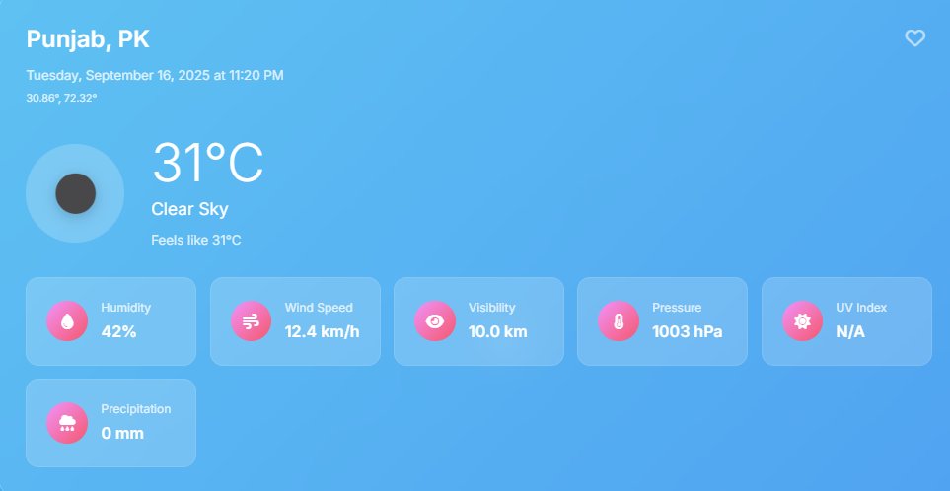
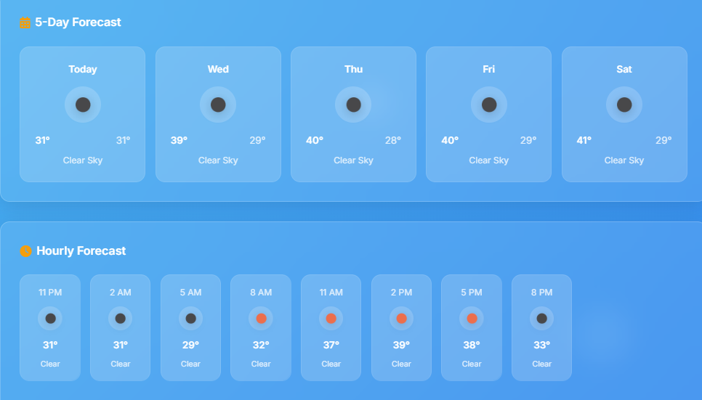
Expected output/Results

Slide 12
Applications
Personal Use – Plan commutes, outdoor activities, and prepare for emergencies.
Transportation – Assist drivers, pilots, and sailors in safe & efficient route planning.
Agriculture – Support farmers in planting, irrigation, and crop protection.
Event Planning – Enable organizers to prepare contingency plans for outdoor events.
Energy – Help utilities forecast demand & manage renewable energy sources.

Slide 13
Future Enhancements
Future Enhancements
Hourly & Multi-Day Forecasts
  Detailed hourly updates (24–48 hrs).
  5–7 day summary for better planning.
Interactive Weather Maps
  Real-time radar for precipitation, wind, cloud cover.
  Visual understanding of weather patterns.
Severe Weather Alerts
  Instant notifications for storms, floods, extreme temperatures.
  Location-based timely warnings.

Slide 14
Refrences
SlideShare – Weather Forecasting
https://www.slideshare.net/slideshow/weather-forecasting
SlideTeam – Forecasting System Templates
https://www.slideteam.net/top-10-weather-forecasting-system-powerpoint-presentation-templates
Slidesgo – Weather Forecasting Presentation
https://slidesgo.com/theme/weather-forecasting

Slide 15
Thank You

